Slide 1
Introduction to R
Setup, R Interface, and intro to basics
By Kelsey Huntzberry, MPH

Slide 2
Class Live Stream Link
To connect to the live stream of class so you can see my shared screen enter this link: https://join.skype.com/BnvN2P9bJSEO
NOTE: You do NOT need a skype account to connect

Slide 3
What Will We Be Learning?
All the basics that beginners need to become regular R users!
Major topics:
Data types and structures and how they are used
Basic essential R functions
Loading and exporting data
Calculating descriptive statistics
Graphing

Slide 4
My Background
Education
Double BA in political science and psychology from Swarthmore College
Master in Public Health (MPH) with a specialization in Health Policy Analysis from Washington University in St. Louis

Slide 5
My Background
Work Experience
Statistical Data Analyst at Washington University in St. Louis
Data Scientist at Bayer Crop Science
Current: Data Science Analyst at Whole Foods Market
Taught Intro to Data Science, Introduction to R, and Intermediate R to colleagues at Bayer Crop Science

Slide 6
Introduction to R Programming: Class Outline
Class 1
Review course outline
Why learn R?
Installing R
R Interface
Intro to basics
Class 2
Vectors
Matrices
Class 3
Factors
Data frames
Class 4
Lists
Essential Functions
Calculating descriptive statistics
Class 5
All about graphing in ggplot2

Slide 7
Intermediate R Programming
After the first 5 classes are complete, we will proceed with intermediate topics such as:
Data manipulation with dplyr
String manipulation with stringr
Loops
User-defined functions
I am open to suggestions about other topics!

Slide 8
Why Learn R?
Popular (Top 3 in Data Science)
Strong in graphics and statistics
Fast and efficient
Open source
Can be automated
Useful for careers in many fields!

Slide 9
Graphing
Uses for R Programming
Mapping
Machine Learning
Creating Website & Interactive Graphs with RShiny
Image Analysis
Statistical Analysis & Modeling
Deep Learning
Simulation & Resource Optimization
Notes:
Give specific example of something I have done in R in job setting

Slide 10
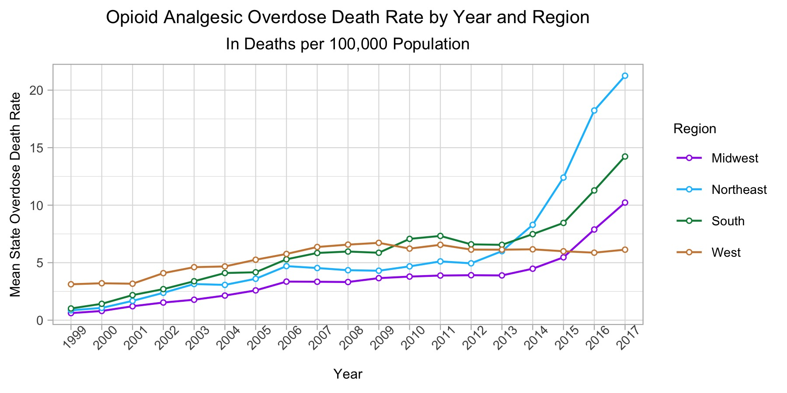

Slide 11
Class Content
Class content:
Instructional content in PowerPoint (slides shared day before class!)
Examples to demonstrate every major concept
Optional exercises to do at home
These will be reviewed during the next class

Slide 12
Streaming and Recording of Class
For each class I will create a Skype meeting
You do NOT need a Skype account to join the meeting
I will live stream the class
I will also record the class for future student use
You will receive an email through Meetup by 9 AM the morning of class with the link to join the meeting
Notes:
Give Github link on slidesou

Slide 13
Getting Help
Have a coding error you do not know how to solve?
Google it!
Best resources I have found are:
Stack Overflow (https://stackoverflow.com/) *This one is often your best option!
R Bloggers (https://www.r-bloggers.com/getting-help-with-r-programming-useful-survival-skills/)
Quick R (https://www.statmethods.net/)
STHDA (http://www.sthda.com/english/wiki/getting-help-with-functions-in-r-programming)
Notes:
Give Github link on slidesou

Slide 14
Collaboration
I created a public class Github repository
The name of the repo is Intro_R and the link is here: https://github.com/kelsey-huntzberry/Intro_R
This is where I will share class PowerPoints and code
Slack channel for group chat
Slack is a chat forum where you can ask questions
Slack channel name: r-programming-class
Slack channel link: https://join.slack.com/t/learningrinaustin/shared_invite/enQtNjQ3MTcxMTczOTQyLTU4NWU2OGU5ZWQ5YzIwMTRhYjRiZTI3ODM1Yjc3ZTcwY2VjOGZkNjg2MzE1ODA1ZDA0YTRjMzNjYmIxOWQ1YmM
Notes:
Give Github link on slidesou

Slide 15
Code Sharing
All in-class and optional outside-of-class code will be shared on Github
I will provide all R code
Optional practice exercises
I will provide optional practice exercises every class
The coding challenges will be written in .R file code comments
Solutions will be posted by Thursday each week
Notes:
Give Github link on slidesou

Slide 16
Office Hours?
Tell me your opinion on Slack within the next week or two if these would be helpful!
Would meet for ~half hour in a coffee shop near the class location
Notes:
Give Github link on slidesou

Slide 17
Installing Base R and RStudio

Slide 18
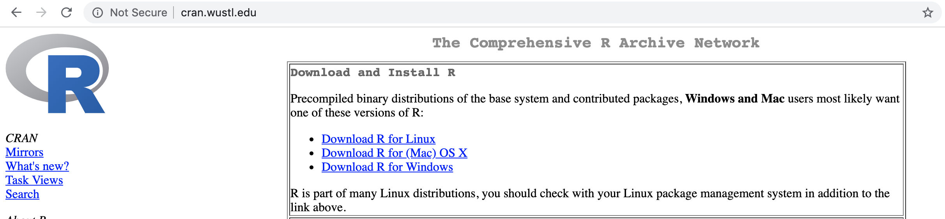
Installing Base R
Go to this link: http://cran.wustl.edu
With this CRAN, can be set up with one file
Easy and straightforward
Choose “Download R” link for your operating system
Notes:
Give Github link on slidesou

Slide 19
What Version of R Should I Download?
Do you ever want to connect to a database through R?
If you think the answer is no, download the most recent version!
If yes, I recommend downloading R 3.4.4
Connecting to a database through ROracle can only be done with a version of 3.4.4 and below
Notes:
Give Github link on slidesou

Slide 20
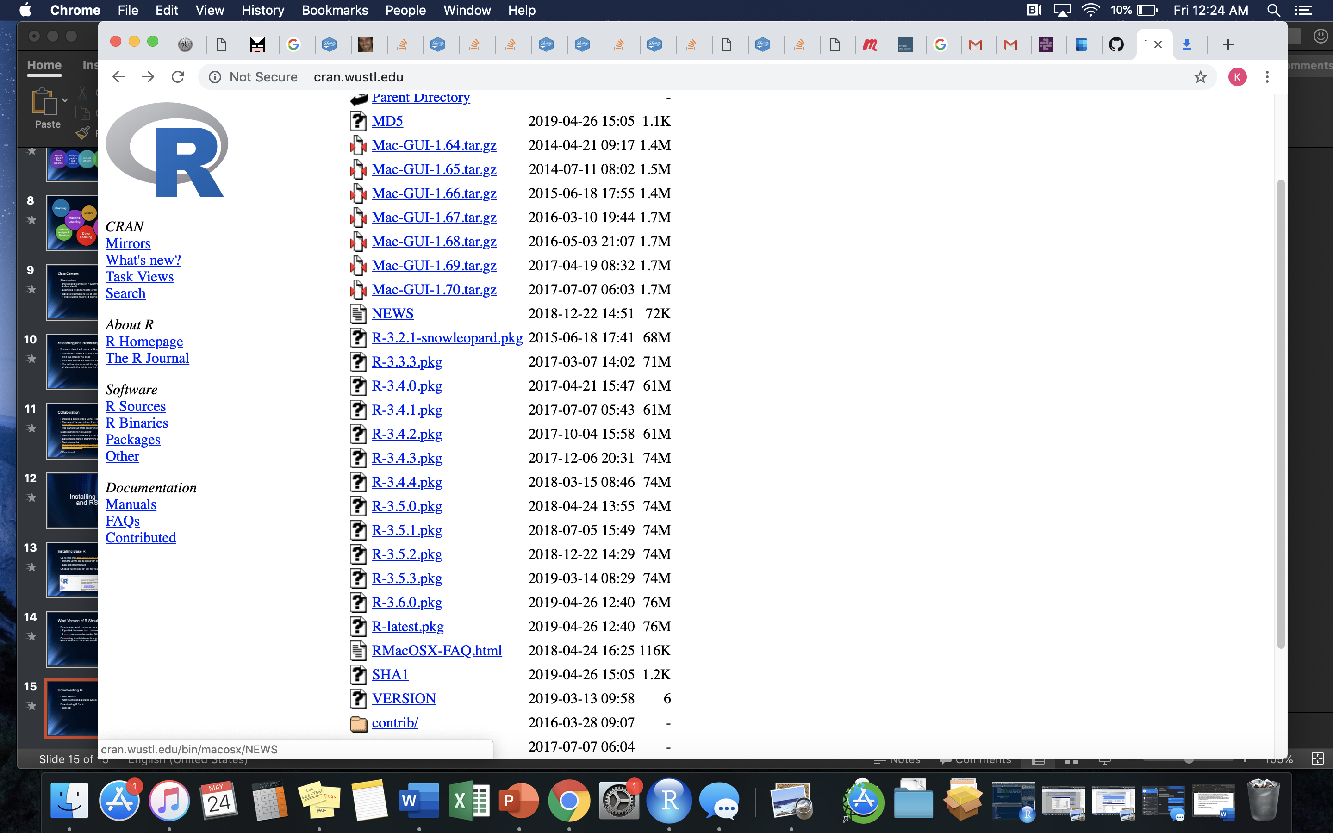
Downloading Base R
Latest version:
After you choosing operating system, click R-latest.pkg link towards the bottom of your screen
Downloading R 3.4.4:
Click R-3.4.4.pkg about halfway down the screen

Slide 21
Downloading Base R
After you click the link:
Let the download finish
Open file
Follow on screen instructions

Slide 22
Difference between Base R & RStudio
Base R allows the program to run on your computer
You can program in Base R but I do not recommend it
It is difficult to use!
We will use Rstudio:
An interface that is easy to use
Can easily see:
Code
Results
Plots
Get help
Notes:
Give Github link on slidesou

Slide 23
Downloading RStudio
Go to this link: https://www.rstudio.com/products/rstudio/download/
I will be using RStudio Desktop
RStudio Server runs on the cloud
You are welcome to use it if you prefer
However, I will not be covering cloud-related troubleshooting in this course
Click Download to version you want
Choose your operating system
Let file load, open it, and follow on-screen instructions
Notes:
Give Github link on slidesou

Slide 24
R Interface & Essential Basic Commands

Slide 25
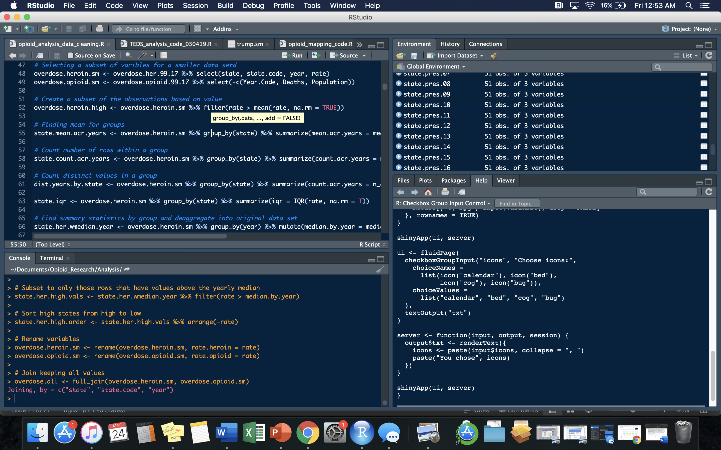
Workspace: All objects in your environment will be found here. Shows more information about data types and contents if you click on blue arrow.
Source Brower: You will create and interact with your R scripts and projects here
Console: You can type code directly in this area. Recommended for quick testing only. Will not be saved for further use.
Interact with your files, help documents, packages, and see plots here.

Slide 26
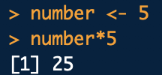
Most Basic Elements
In R use <- or = to assign values to a variable
Data science best practice is to use <-
Example: state <- “Texas”
To refer to a single variable within a data frame, use $
Example: data.frame$variable
Can perform arithmetic on values
Notes:
Give Github link on slidesou

Slide 27

All about Vectors
The most basic element in R is a vector
All other elements are made up of vectors
Vector: Series of multiple values of the same type in one dimension
Variable Name
Assignment
Vector Values
Notes:
Give Github link on slidesou

Slide 28
Set Your Working Directory
Connect RStudio to a specific folder on your computer by setting a working directory
Can directly:
Import files into RStudio from folder
Export files into folder from RStudio
Structure for Windows:
setwd("C:/Documents/Data_Folder")
Structure for Mac:
setwd("~/Documents/Data_Folder")
Check working directory by using getwd()
NOTE: You can use / or \\ to set working directory (directly pasting a file path will NOT work!)
Notes:
Give Github link on slidesou

Slide 29
Importing Data
To import a .csv file from your working directory use this code format:
new.df <- read.csv(“name_you_want_for_your_file.csv”)
Example:
opioid.df <- read.csv("~state_prescribe_overdose_data.csv")
You can also add a file path to send to another folder!
Add stringsAsFactors = F to import strings as characters instead of factors
opioid.df <- read.csv("state_prescribe_overdose_data.csv", stringsAsFactors = F)
Notes:
Give Github link on slidesou

Slide 30
Exporting Data
To export a data frame to .csv format into your working directory use the following command and format:
write.csv(r.data.frame.for.export, “name_you_want_for_your_file.csv”)
Example:
write.csv(mean.overdose.by.year, "mean_overdose_by_year.csv")
You can also add a file path to send to another folder!
Notes:
Give Github link on slidesou

Slide 31
Installing & Loading Packages
To install an R package, follow this format:
install.packages(“psych”)
To load the package into your R session use this format:
library(psych)
You have to install your packages once
You have to load your packages every time you open a new R session
If you close R, you will have to load your packages again
Notes:
Give Github link on slidesou

Slide 32
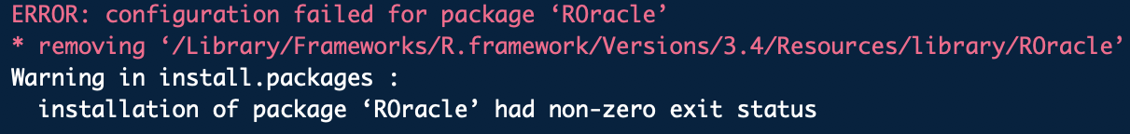
Package Loading Error?
If you see an error like what you see below:
Your package requires dependencies!
This package requires updated Java, Rtools, and several other R packages
These have to be loaded first before you can install the package
Google it!
Notes:
Give Github link on slidesou

Slide 33
Commonly Used Packages
ggplot2
Used to create customized graphs
dplyr
Used for data cleaning, modeling, big data work
stringr
Used for string manipulation
data.table
Runs large data sets quickly
rmarkdown
Chunks code
Can create an HTML print out of code paired with its output
Notes:
Give Github link on slidesou

Slide 34
Coding Demonstration in R

Slide 35
Data Types & Structures

Slide 36
Data Types
Numeric
Example: c(1.2, 2.6, 3.4, 4.1, 5.8)
Character
Example: c(”Alabama”, “Texas”, ”Pennsylvania”)
Integer
Example: c(1, 2, 3, 4, 5)
Logical
Example: c(TRUE, FALSE, FALSE, TRUE)
Check a data type with the class() function
Notes:
Give Github link on slidesou

Slide 37
Data Structures
Variable
Consists of one value
Example: state <- “Texas”
Vector
Series of multiple values of the same type in one dimension
Example: numbers <- c(1, 2, 3, 7, 10)
List
Series of multiple values of different types in one dimension
Example: list.values <- list(1, “Alabama”, 9, TRUE)
Notes:
Give Github link on slidesou

Slide 38
Data Structures
Matrix
Rectangular array of the same type
If they are numbers, you can perform mathematical operations on each value
Data frame
Data created by combining multiple vectors so that each vector becomes a column
Each column can have a different data type
Notes:
Give Github link on slidesou

Slide 39
Questions?

Slide 40
Thank you for attending! Next Class is Vectors & Matrices: Next Saturday, May 24th from 10:30 AM to 12:00 PM To attend in person go here to sign up: https://www.meetup.com/Learning-R-Programming-in-Austin/events/261412773/ To attend online go here to sign up: https://www.eventbrite.com/e/intro-r-vectors-and-matrices-tickets-61769256509 Optional Practice Slides are Available on Github! (link on slide #12)

Slide 41
Contact Info: My email: kelsey.Huntzberry@gmail.com Slack Channel to collaborate with your cohort is called r-programming-class found here: https://join.slack.com/t/learningrinaustin/shared_invite/enQtNjQ3MTcxMTczOTQyLTU4NWU2OGU5ZWQ5YzIwMTRhYjRiZTI3ODM1Yjc3ZTcwY2VjOGZkNjg2MzE1ODA1ZDA0YTRjMzNjYmIxOWQ1YmM

